Slide 1
Tools: Eclipse, Selenium, Java, TestNG, Maven, ExtentReports, Excel, Jenkins, Jira, Zephyr
Capstone Project: Automated Testing on Demoblaze
Name - Rohan Chauhan
Email - chauhanrohan425@gmail.com
Superset ID – 4625383
Repository URL : - https://github.com/cjhauhan/Capstone_Project_on_DemoBlaze.git

Slide 2
Introduction
Objective: Automate Demoblaze e-commerce website
Validate Authentication, Product Navigation, Cart, Checkout & Reporting
Ensure cross-browser compatibility (Chrome, Firefox)
Agile-Scrum methodology followed

Slide 3
Tools & Technologies
Language: Java
Automation Tools: Selenium WebDriver
Testing Framework: TestNG Framework
Cross Browser Testing
Maven Build Tool
Reporting: ExtentReports & Excel (Apache POI)
CI/CD: Jenkins
Test Management: Jira + Zephyr

Slide 4
Approach (Agile-Scrum)
Agile-Scrum methodology adopted
Epics → Stories → Tasks in Jira
Test cycles managed in Zephyr
Continuous Integration via Jenkins

Slide 5
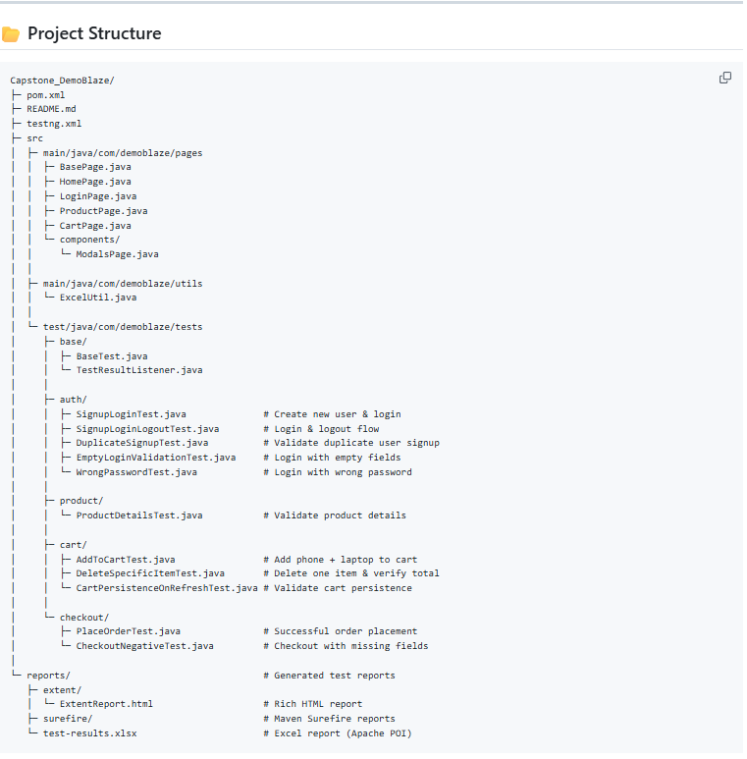
Framework Architecture
Page Object Model (POM)
src/main/java/com/demoblaze/pages
src/test/java/com/demoblaze/tests
utils for Excel & Reporting
testng.xml controls suite execution

Slide 6
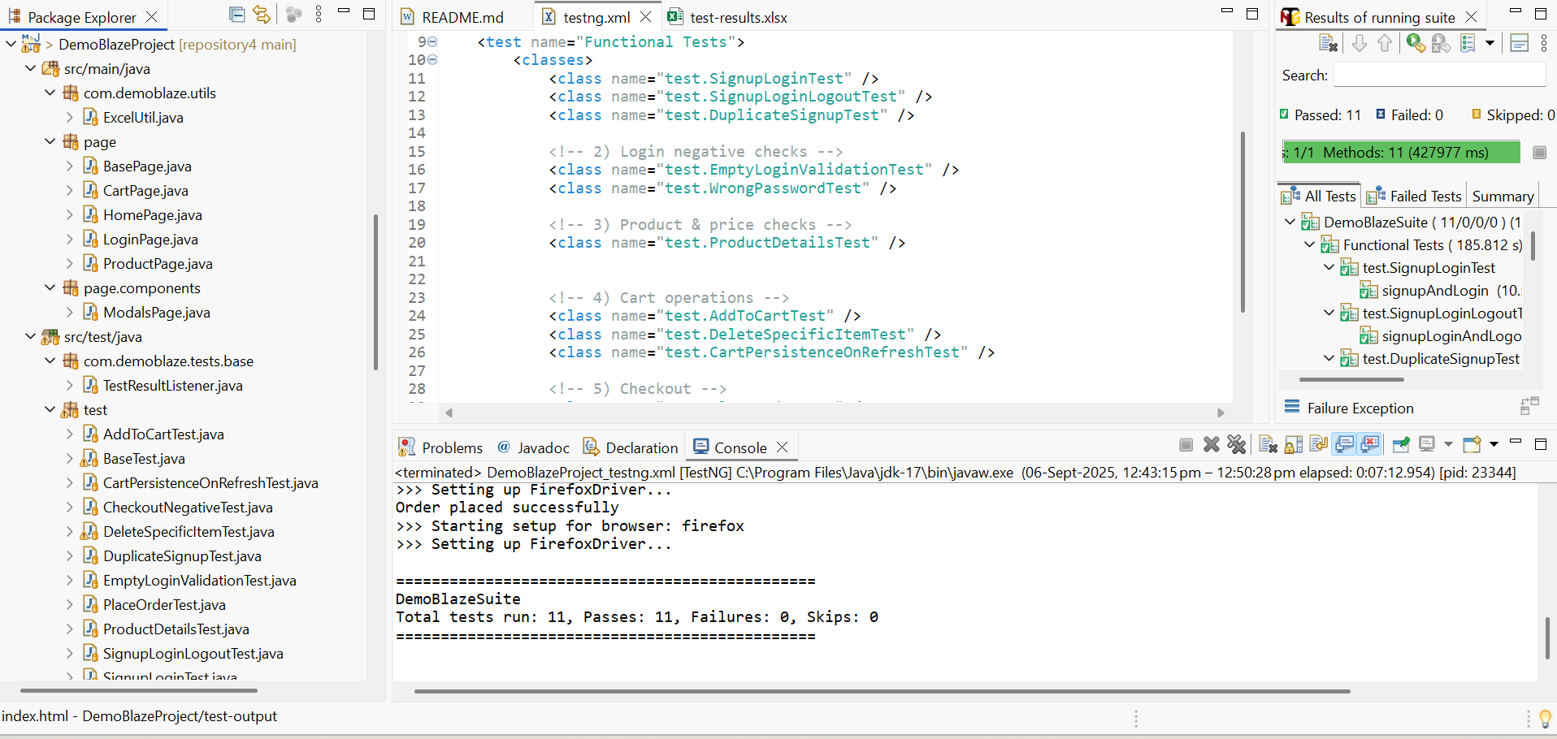
Test Coverage
Total Test Cases: 11
Positive: 7
Negative: 4
Covers Signup, Login, Logout
Product details & filters
Cart add/delete/persistence
Checkout flows
Reporting validation

Slide 7
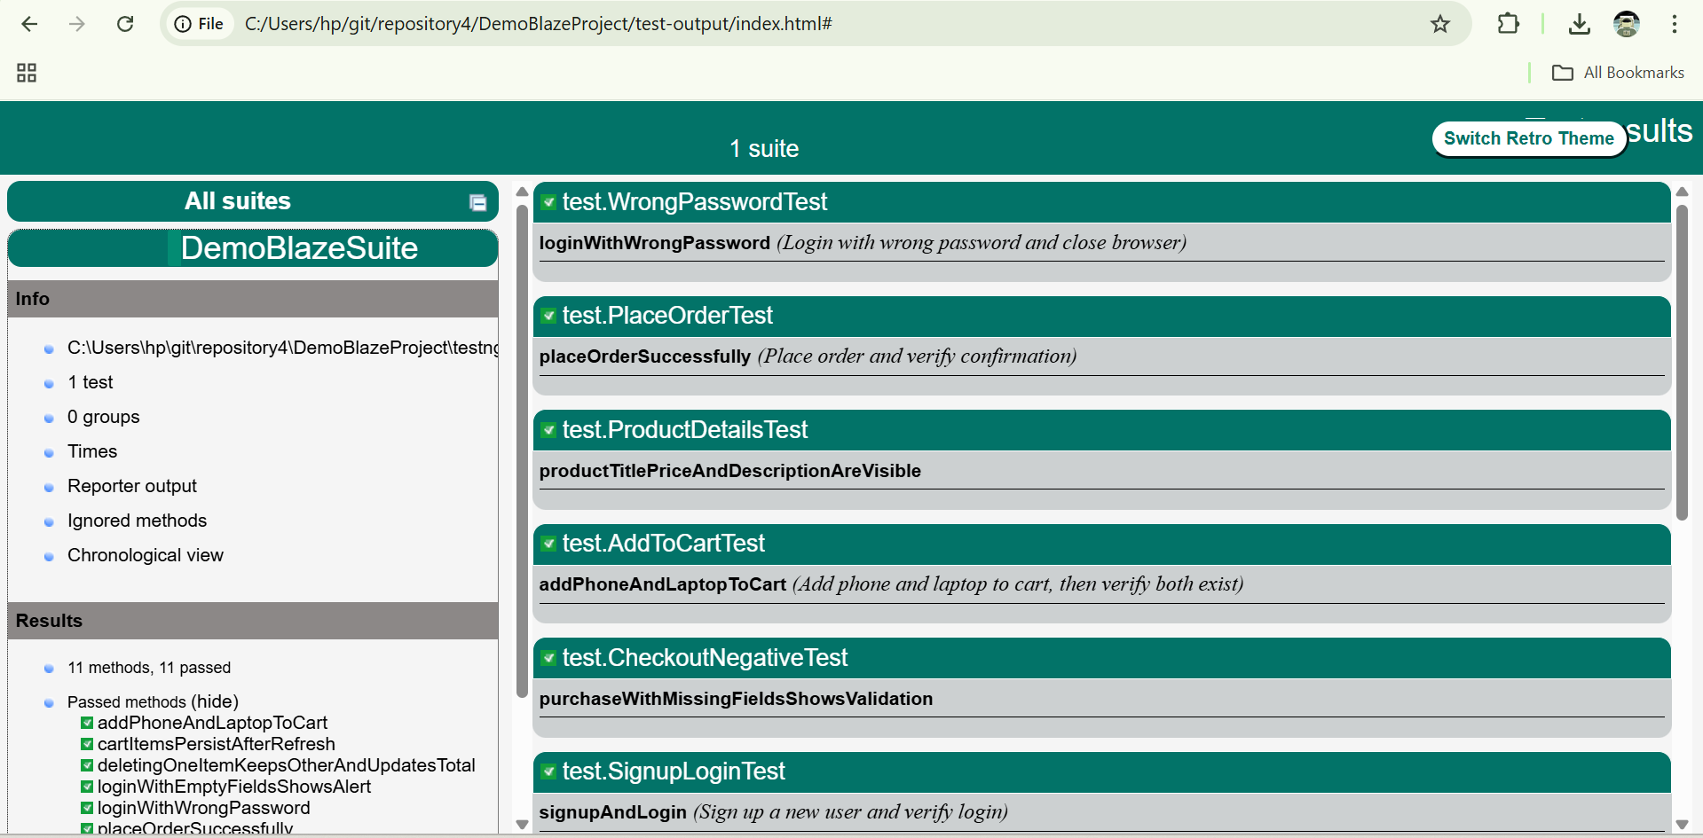
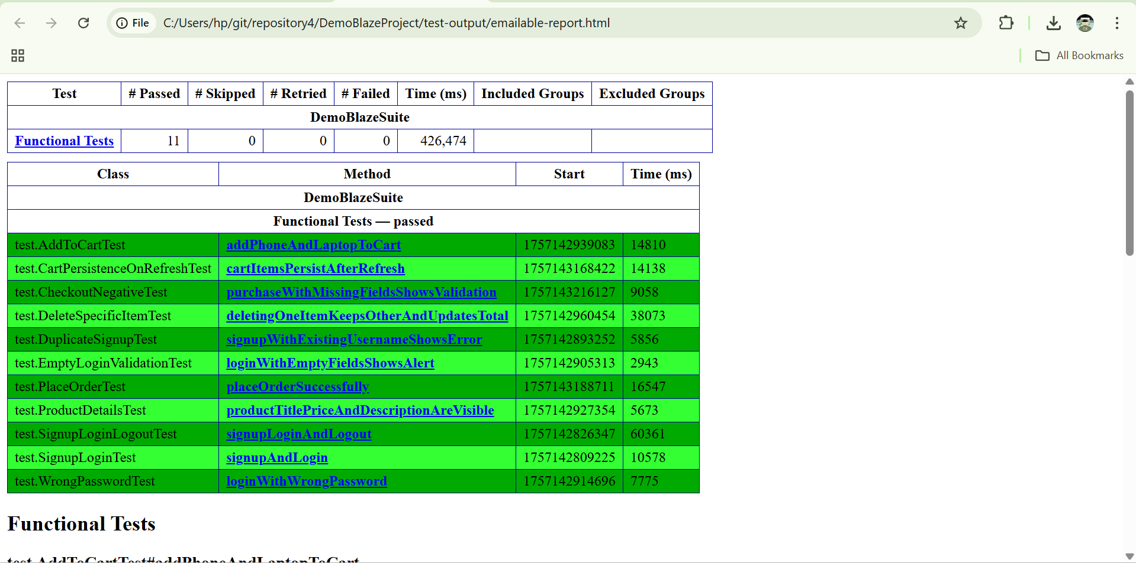
Reporting
ExtentReports: HTML UI with screenshots
Excel Report: Executed test summary
TestNG: Console & default HTML

Slide 8
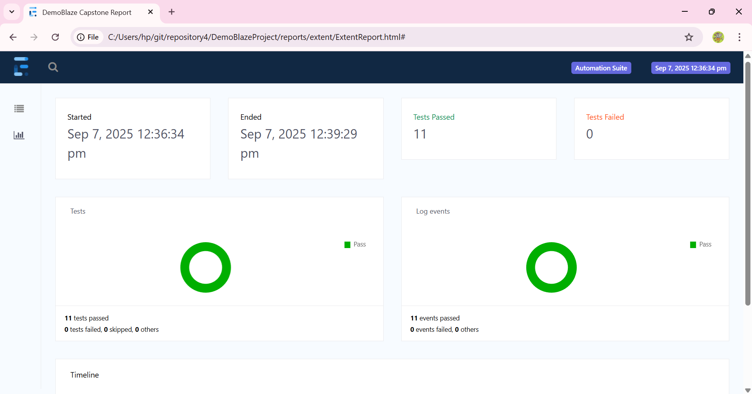
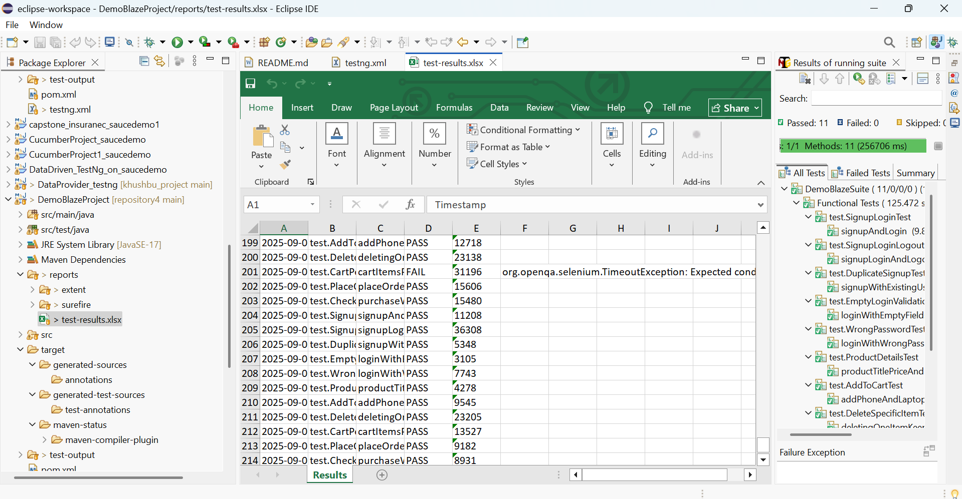
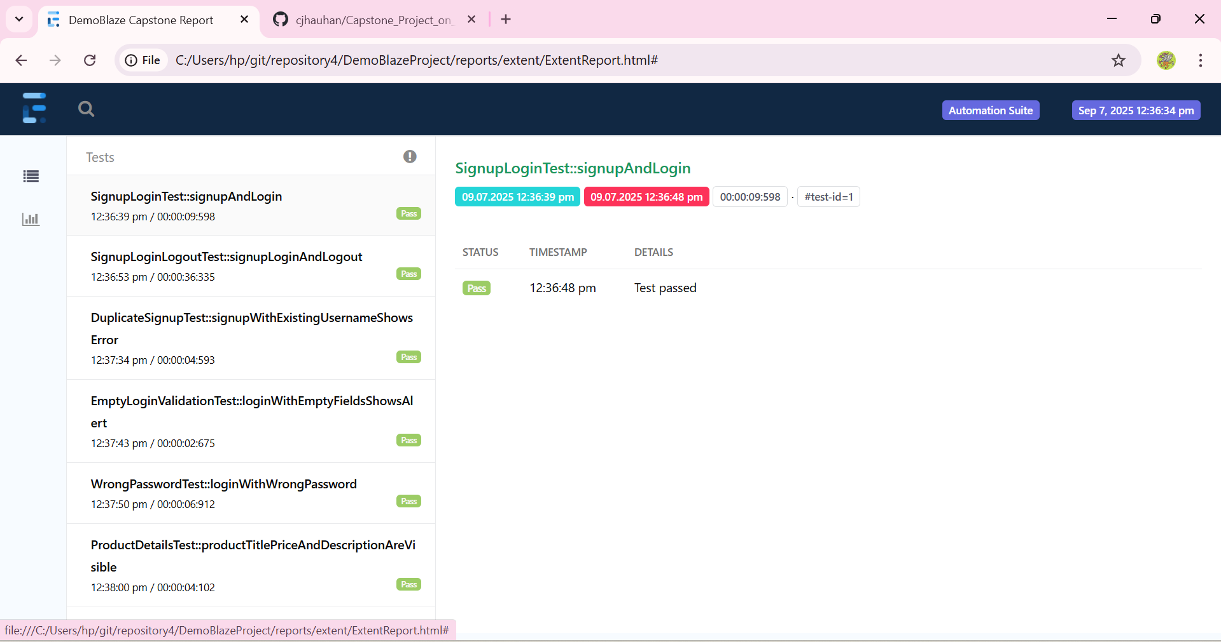
Reporting

Slide 9
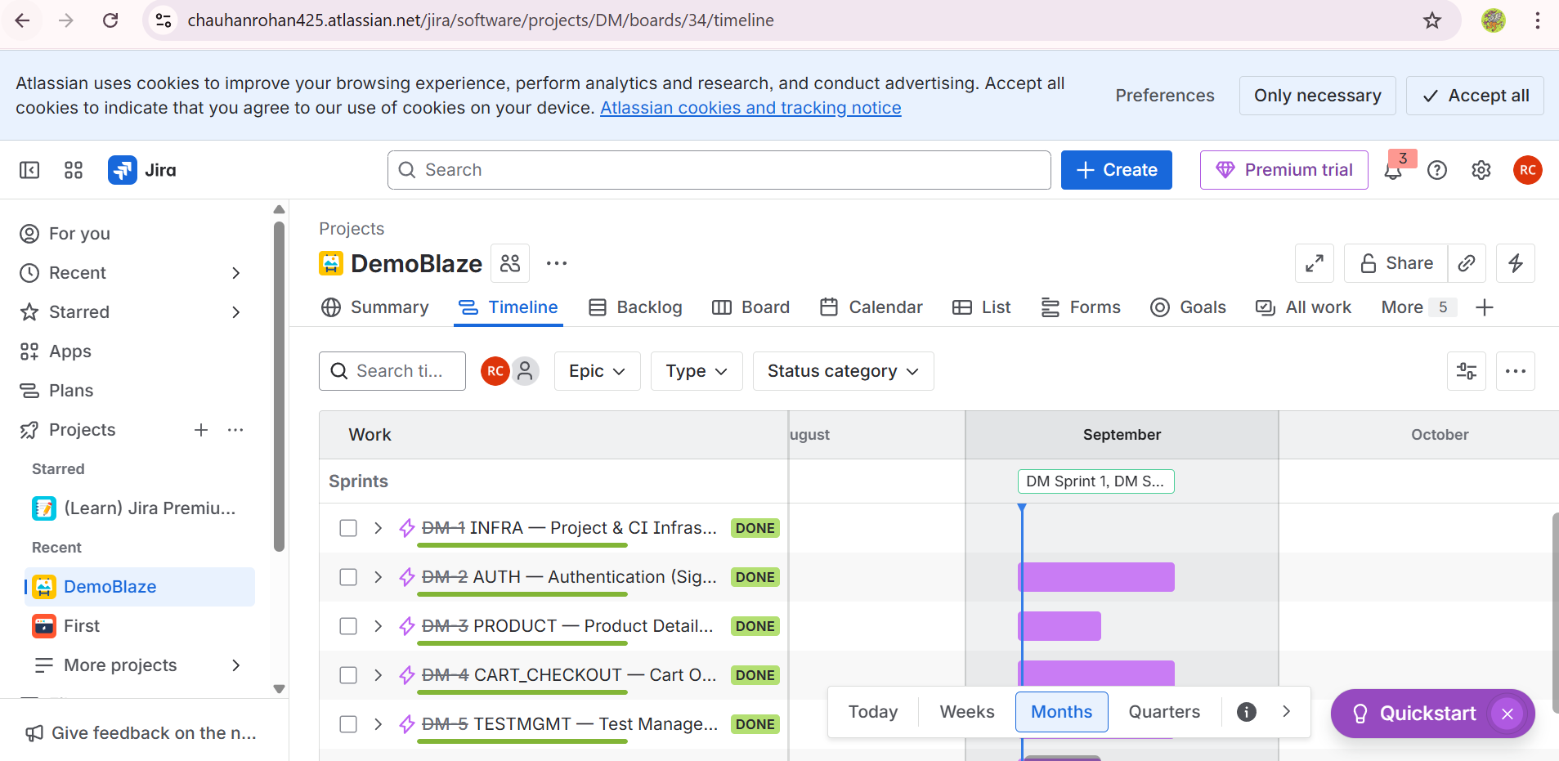
Jira
Epics created for Auth, Product, Cart, Checkout, Reporting.
Stories mapped to test classes.
15 test cases added in Zephyr.
Bugs logged for duplicate signup, cart total mismatch, Excel report issue.

Slide 10
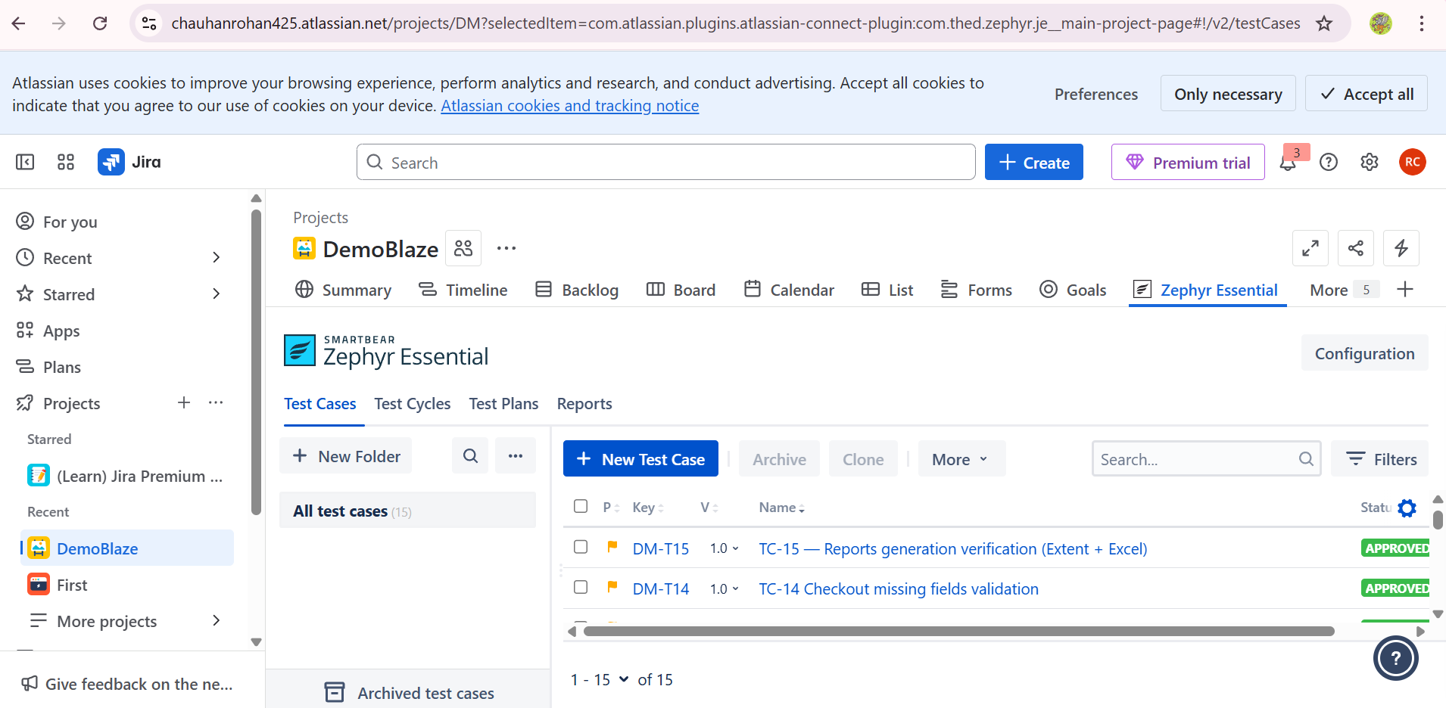
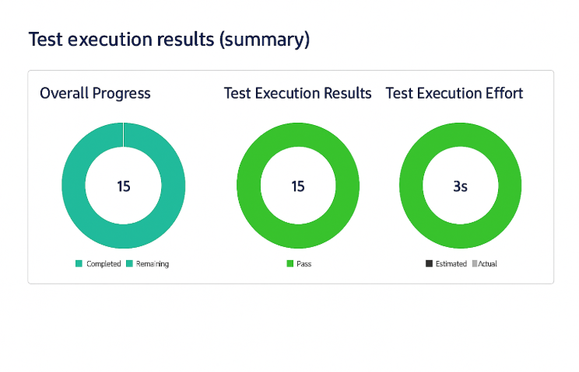
Jira

Slide 11
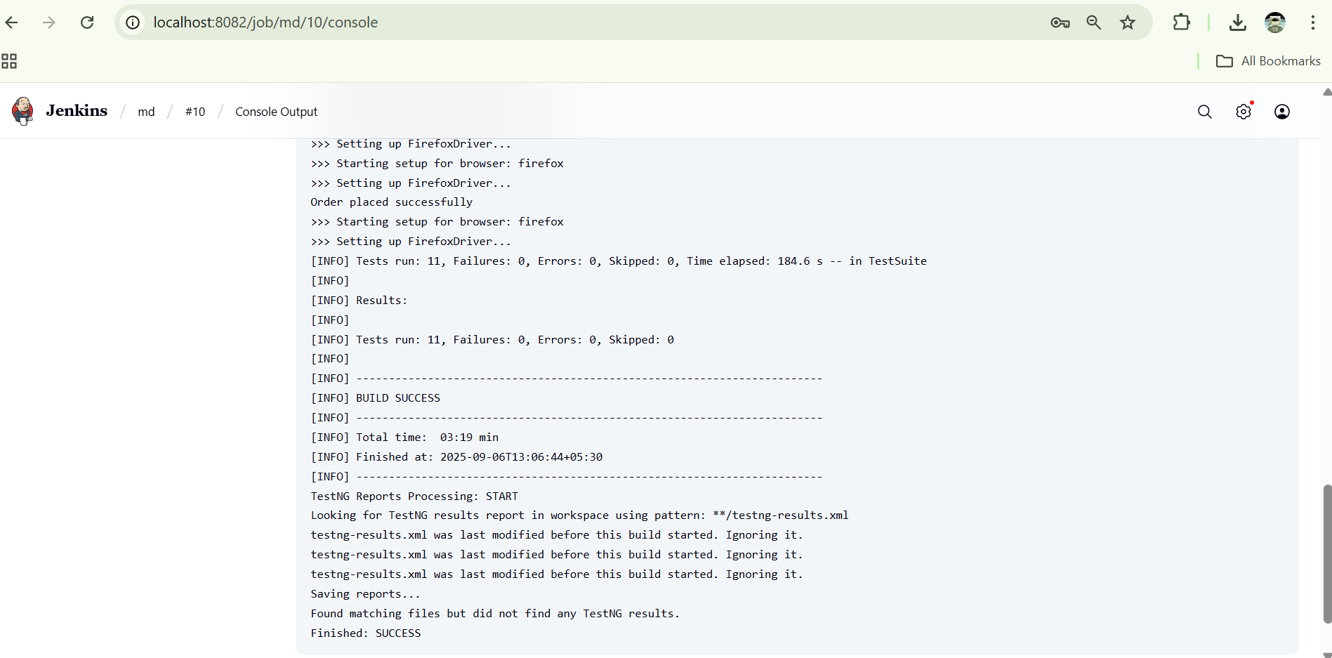
CI/CD with Jenkins
Jenkins pipeline integrated with Maven + TestNG
Executed on Chrome & Firefox
Generates Extent + Excel reports
Artifacts archived and linked in Jira

Slide 12
Key Learnings
Automation framework design (POM)
Test lifecycle with Jira + Zephyr
CI/CD automation with Jenkins
Professional HTML & Excel reporting

Slide 13
Thank You
Capstone Project on Demoblaze Automation Testing
Open for Questions

